Slide 1
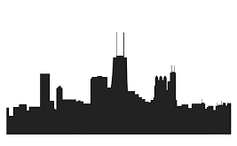


FOOD DESERTS BY ZIPCODE
DATA SOURCES
How Big is the Problem in Three Largest U.S. Cities?
Los Angeles
Chicago
New York

Slide 2
Data Sources for Food Deserts by Zip Code
There are three sets of data needed for this analysis
  Income by Zip Code
  Zip Codes in target cities
  Grocery Stores near a Zip Code
The next pages explain these data sources and their use.

Slide 3
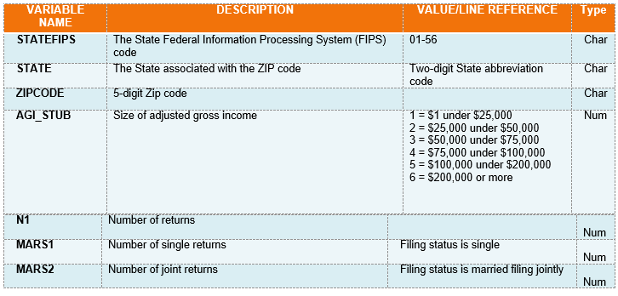
Data Sources – Income by Zip Code
For income by zip code, this analysis will be using the 2017 income tax file available at https://www.irs.gov/statistics/soi-tax-stats-individual-income-tax-statistics-2017-zip-code-data-soi. The IRS data contains information by 6 major income groups for each zip code and indicates the individual line item information on U.S. Income Tax forms 1040, 1040A, 1040EZ. The information will be used to create an average income by zipcode for correlation and comparative purposes.
The Data Dictionary for this file can be downloaded here. here. (This will open in a Word instance.) Some rows from the Data Dictionary are below:

Slide 4
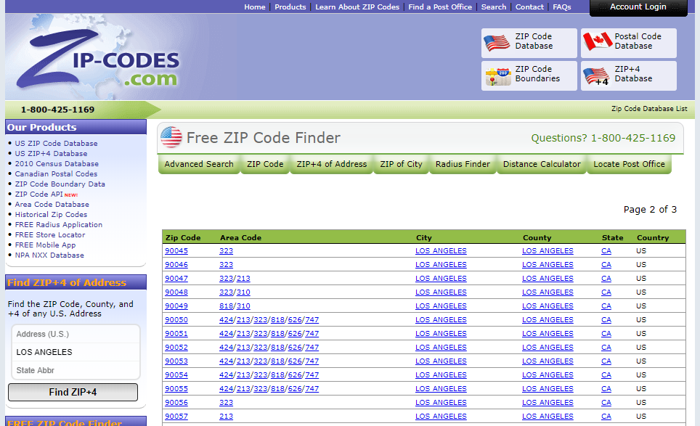
Data Sources – Target City Zip Codes
To retrieve zip codes for each city, this analysis will be using information from for www.zip-codes.com the three cities using the city names as keys for the data. The data will be scraped from the web site and refined as needed.
Screen shot of
Los Angeles Zip Code data

Slide 5
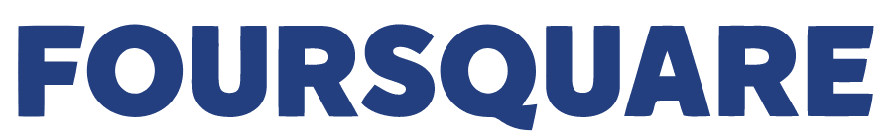
Data Sources – Grocery Stores by Zip Code
To identify grocery stores by Zip code, FourSquare data will be used.
The following categoryId keys will be used to identify the grocery stores:
    grocery_store = '4bf58dd8d48988d118951735'
    organic_grocery = '52f2ab2ebcbc57f1066b8b45'
    supermarket = '52f2ab2ebcbc57f1066b8b46‘
The range for the grocery stores will be 804 meters, approximately ½ mile. This is in line with the USDA’s definition of reasonable grocery store access.
Additional information about venue categories within FourSquare can be found here.

